Slide 1
BLOSUM matrices
Dr. Muhammad Tahir
Assistant Professor
COMSATS University Islamabad, Attock Campus

Slide 2
BLOSUM matrices
Blocks Substitution Matrix. Scores for each position are obtained frequencies of substitutions in blocks of local alignments of protein sequences [Henikoff & Henikoff92].
For example BLOSUM62 is derived from sequence alignments with no more than 62% identity.

Slide 3
BLOSUM Scoring Matrices
BLOck SUbstitution Matrix
Based on comparisons of blocks of sequences derived from the Blocks database
The Blocks database contains multiply aligned ungapped segments corresponding to the most highly conserved regions of proteins (local alignment versus global alignment)
BLOSUM matrices are derived from blocks whose alignment corresponds to the BLOSUM-,matrix number

Slide 4
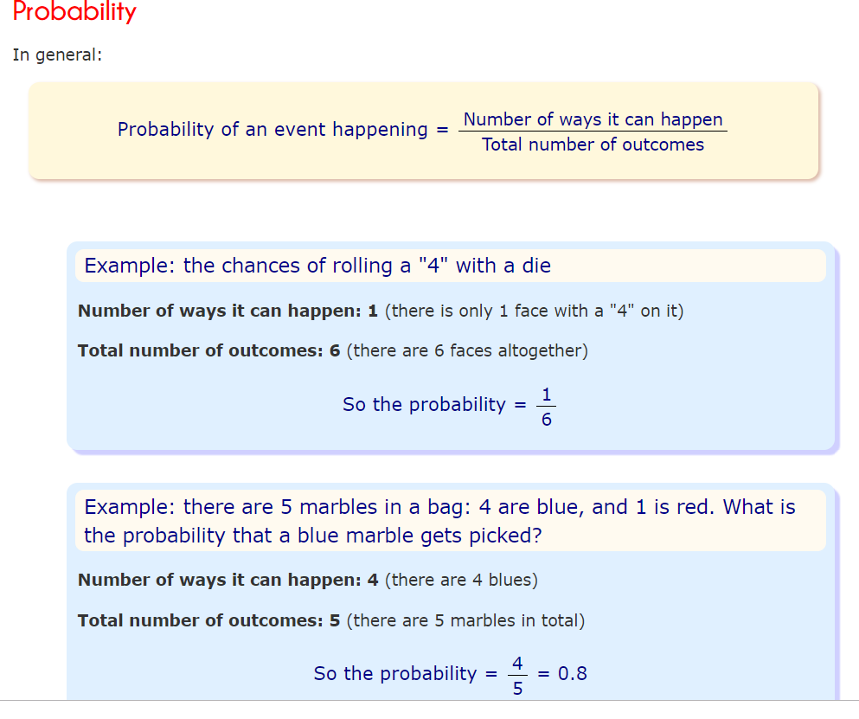

Slide 5
Conserved blocks in alignments
AABCDA...BBCDA
DABCDA.A.BBCBB
BBBCDABA.BCCAA
AAACDAC.DCBCDB
CCBADAB.DBBDCC
AAACAA...BBCCC

Slide 6
Constructing BLOSUM k
To avoid bias in favor of a certain protein, first eliminate sequences that are more than k% identical
The elimination is done by either
removing sequences from the block, or
finding a cluster of similar sequences and replacing it by a new sequence that represents the cluster.
BLOSUM k is the matrix built from blocks with no more the k% of similarity
E.g., BLOSUM62 is the matrix built using sequences with no more than 62% similarity.
Note: BLOSUM 62 is the default matrix for protein BLAST

Slide 7
Collecting substitution statistics
Count amino acids pairs in each column; e.g.,
6 AA pairs, 4 AB pairs, 4 AC, 1 BC, 0 BB, 0 CC.
Total = 6+4+4+1=15
Normalize results to obtain probabilities (p_{X}’s and q_{XY}’s)
Compute log-odds score matrix from probabilities: s(X,Y) = log (q_{XY} / (p_{X} p_{y}))
A
A
B
A
C
A

Slide 8
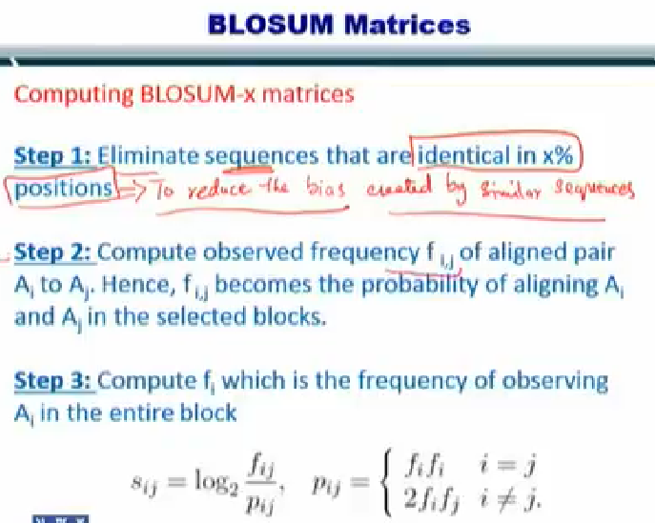

Slide 9
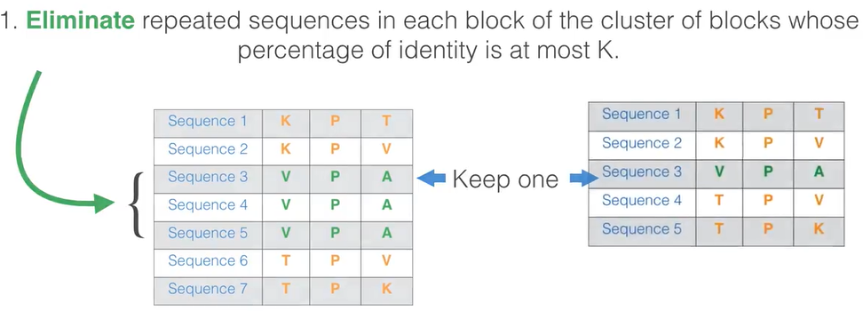
BLOSUM Matrix Computation

Slide 10
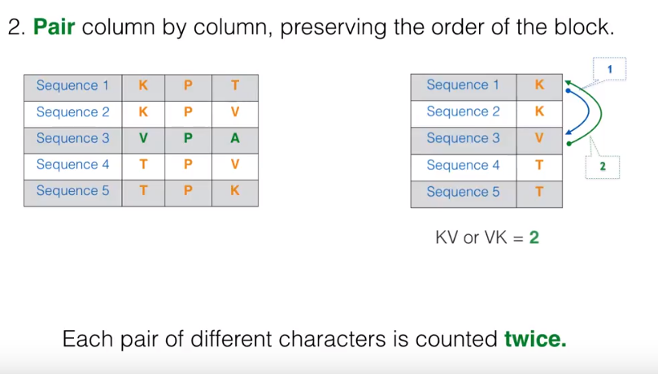
BLOSUM Matrix Computation

Slide 11
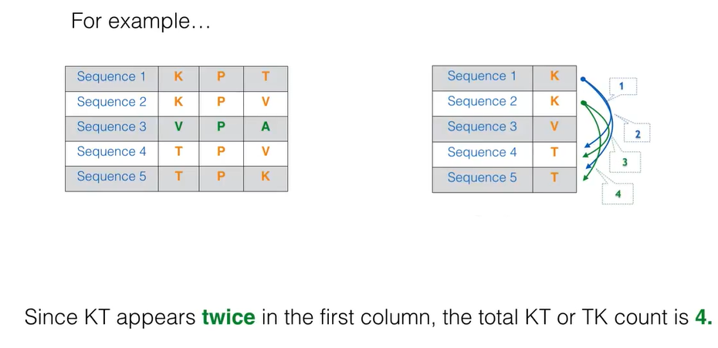
BLOSUM Matrix Computation

Slide 12
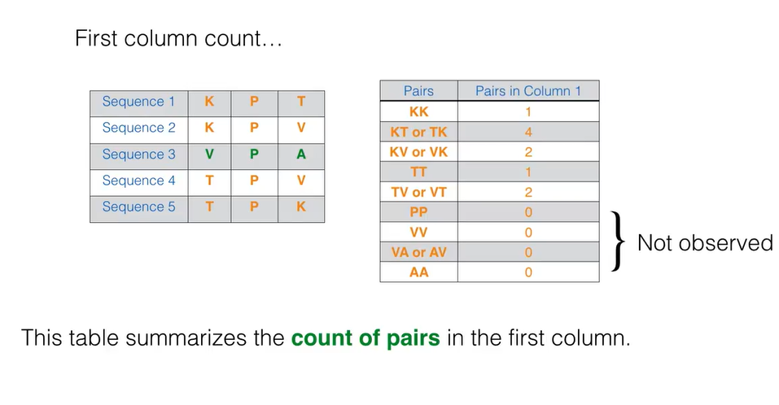
BLOSUM Matrix Computation

Slide 13
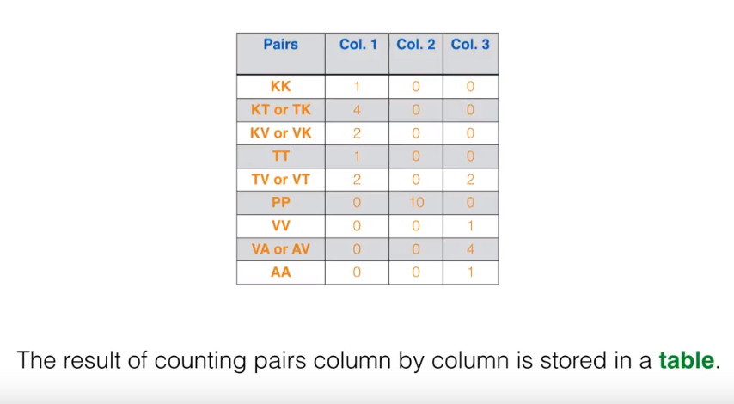
BLOSUM Matrix Computation

Slide 14
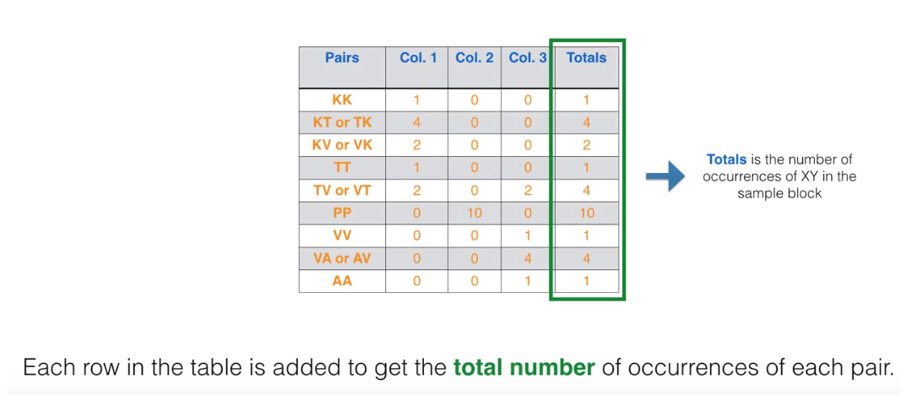
BLOSUM Matrix Computation

Slide 15
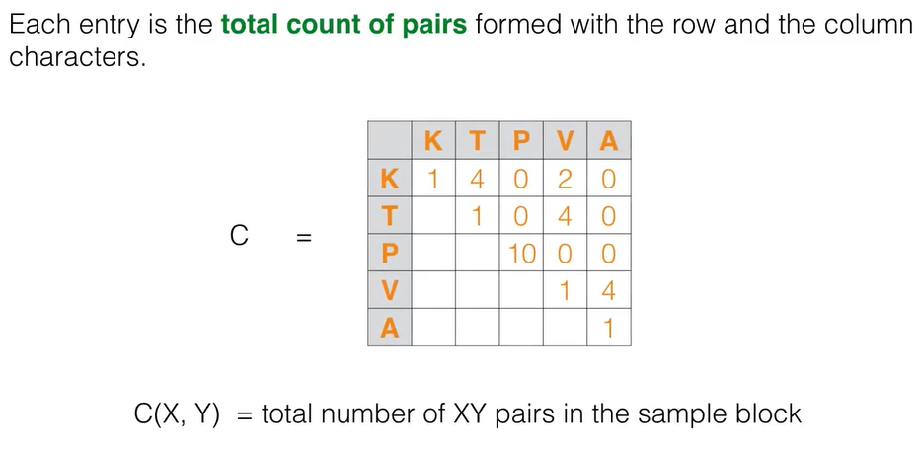
BLOSUM Matrix Computation

Slide 16
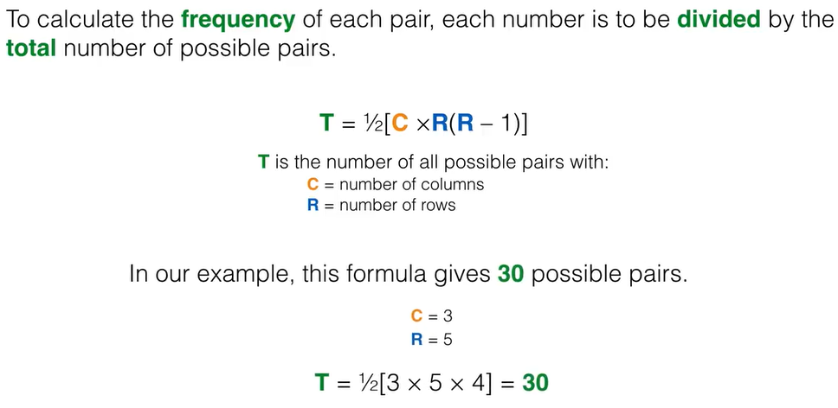
BLOSUM Matrix Computation

Slide 17
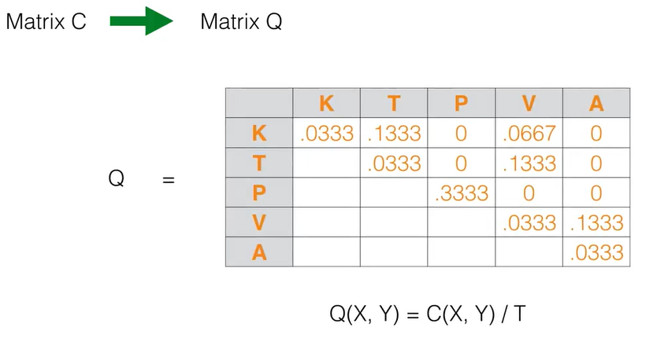
BLOSUM Matrix Computation

Slide 18
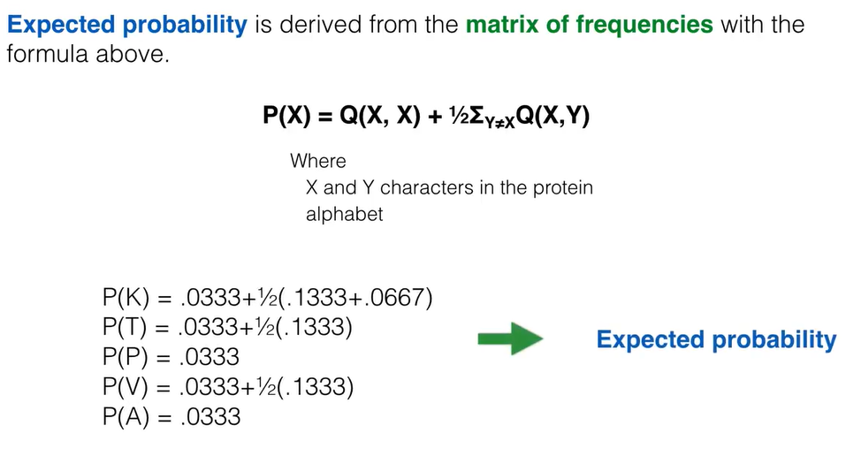
BLOSUM Matrix Computation

Slide 19
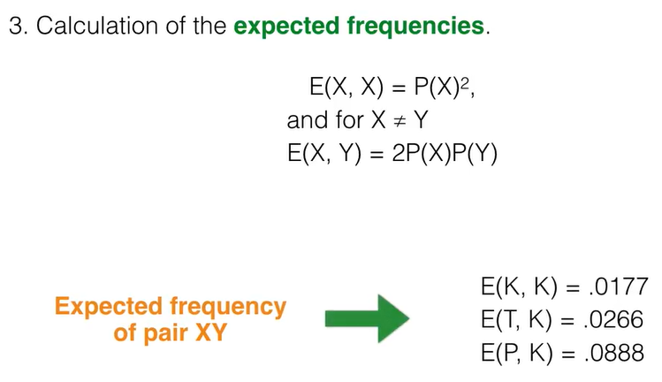
BLOSUM Matrix Computation

Slide 20
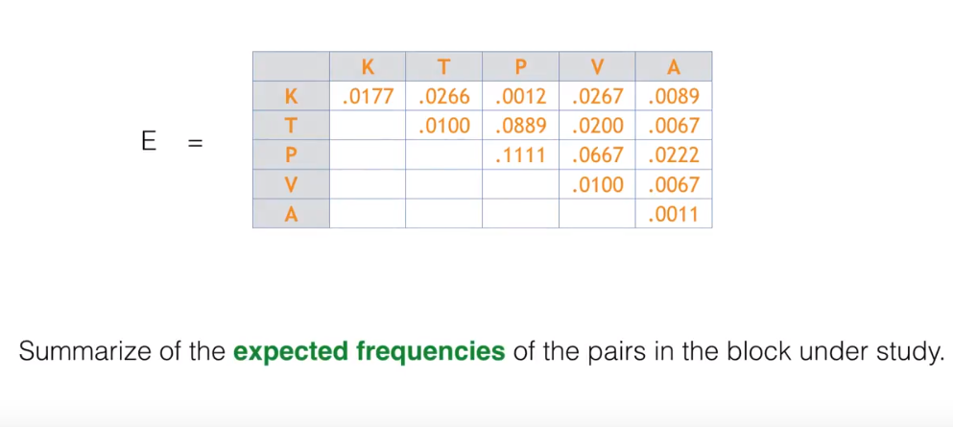
BLOSUM Matrix Computation

Slide 21
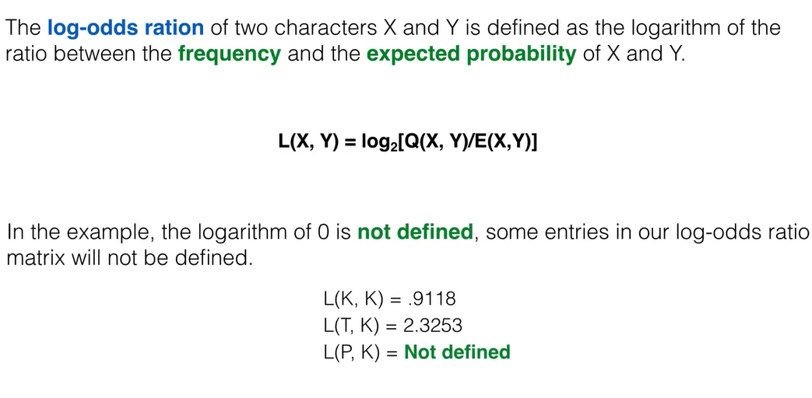
BLOSUM Matrix Computation
Logarithm Calculator: https://www.rapidtables.com/calc/math/Log_Calculator.html
Notes:
Log2 (1.881)

Slide 22
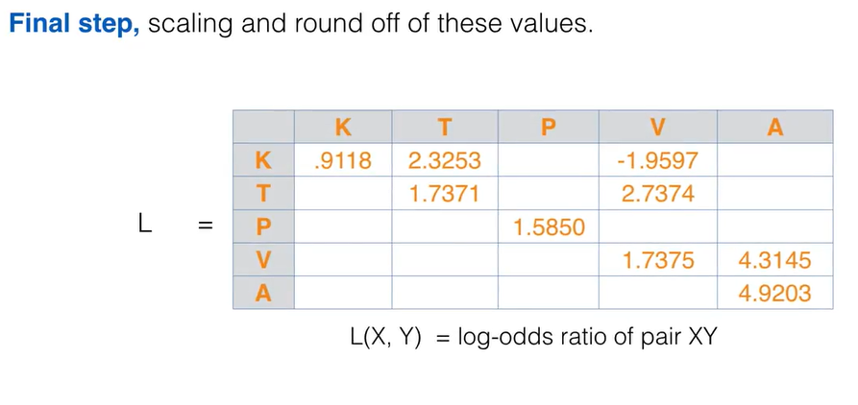
BLOSUM Matrix Computation

Slide 23
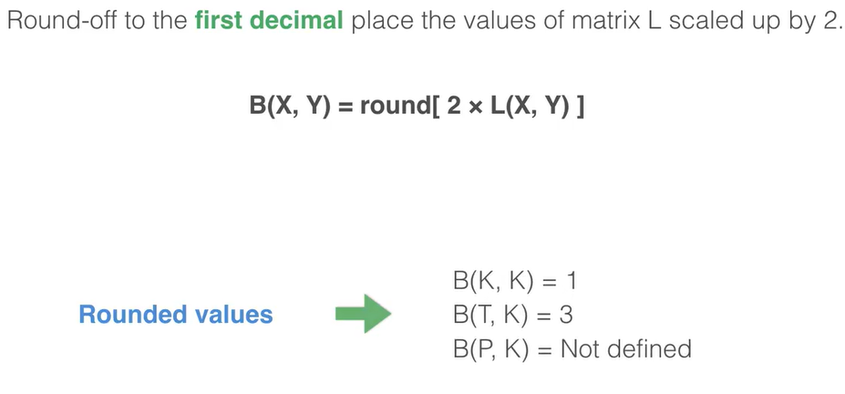
BLOSUM Matrix Computation

Slide 24
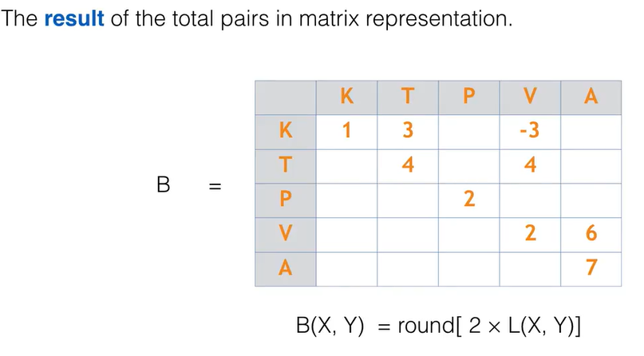
BLOSUM Matrix Computation

Slide 25
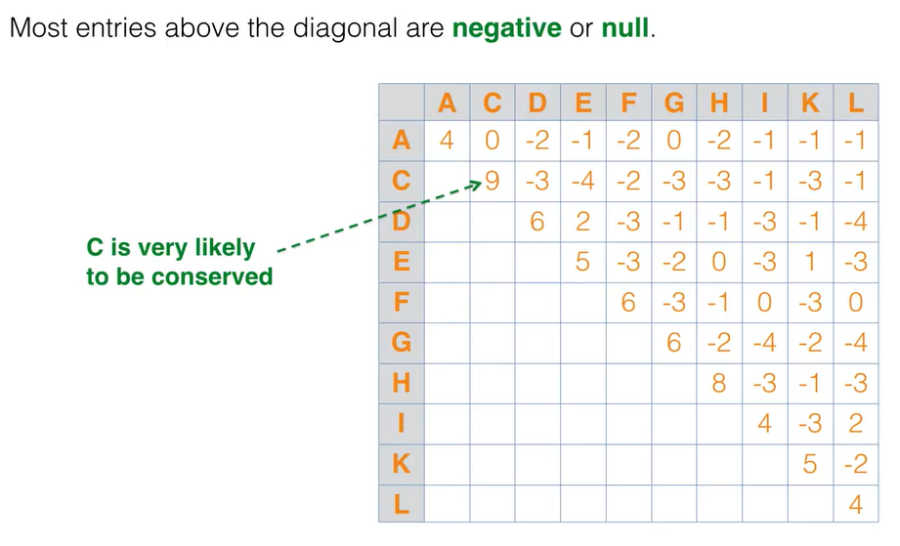
BLOSUM Matrix Computation

Slide 26
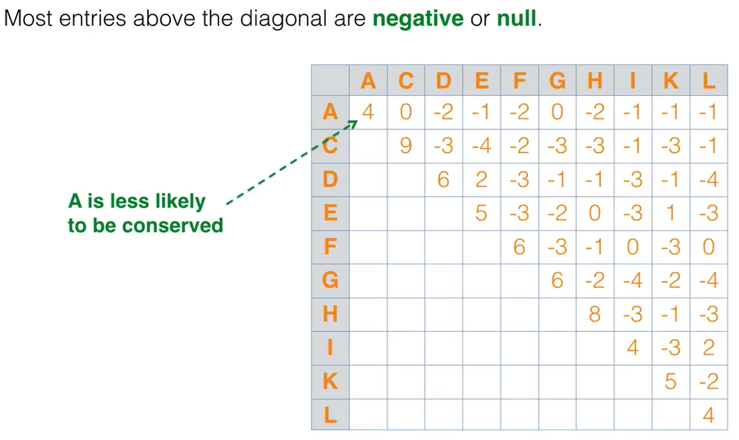
BLOSUM Matrix Computation

Slide 27
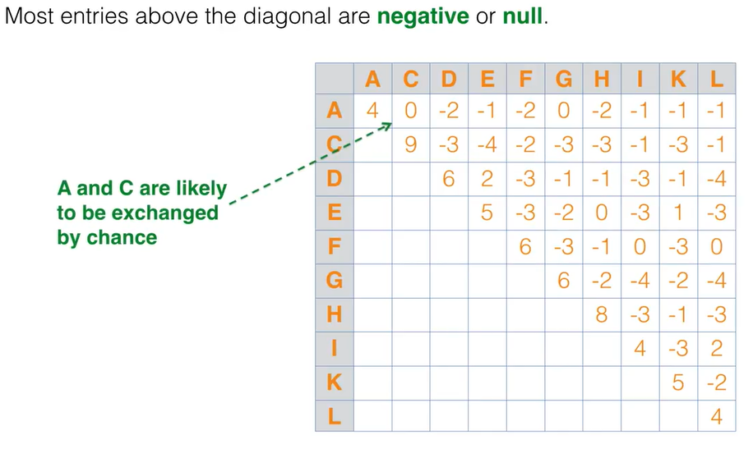
BLOSUM Matrix Computation

Slide 28
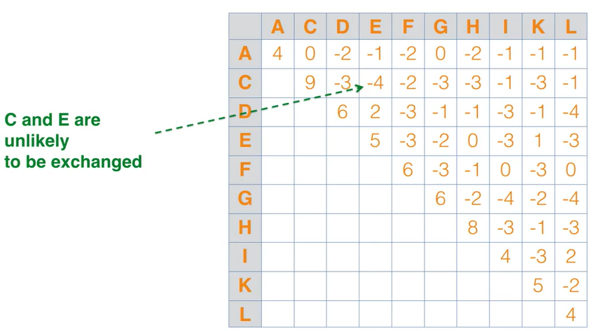
BLOSUM Matrix Computation

Slide 29
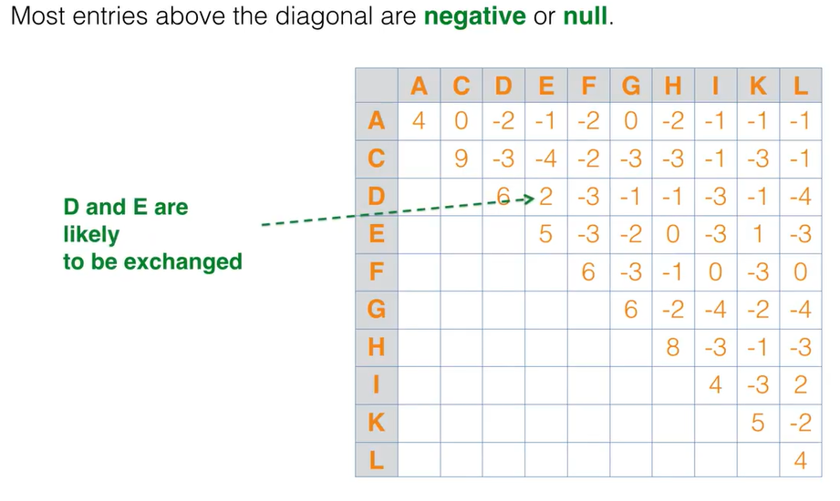
BLOSUM Matrix Computation

Slide 30
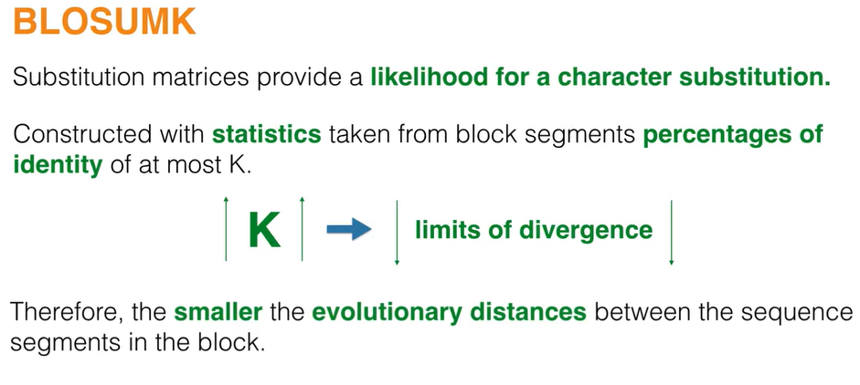
BLOSUM Matrix Computation

